Slide 1


YOLO: Real-Time Object Detection
Machine learning course project
MSc in Computer Engineering, Cybersecurity and Artificial Intelligence
Relator: Andrea Murgia
Anno accademico 2021-2022

Slide 2
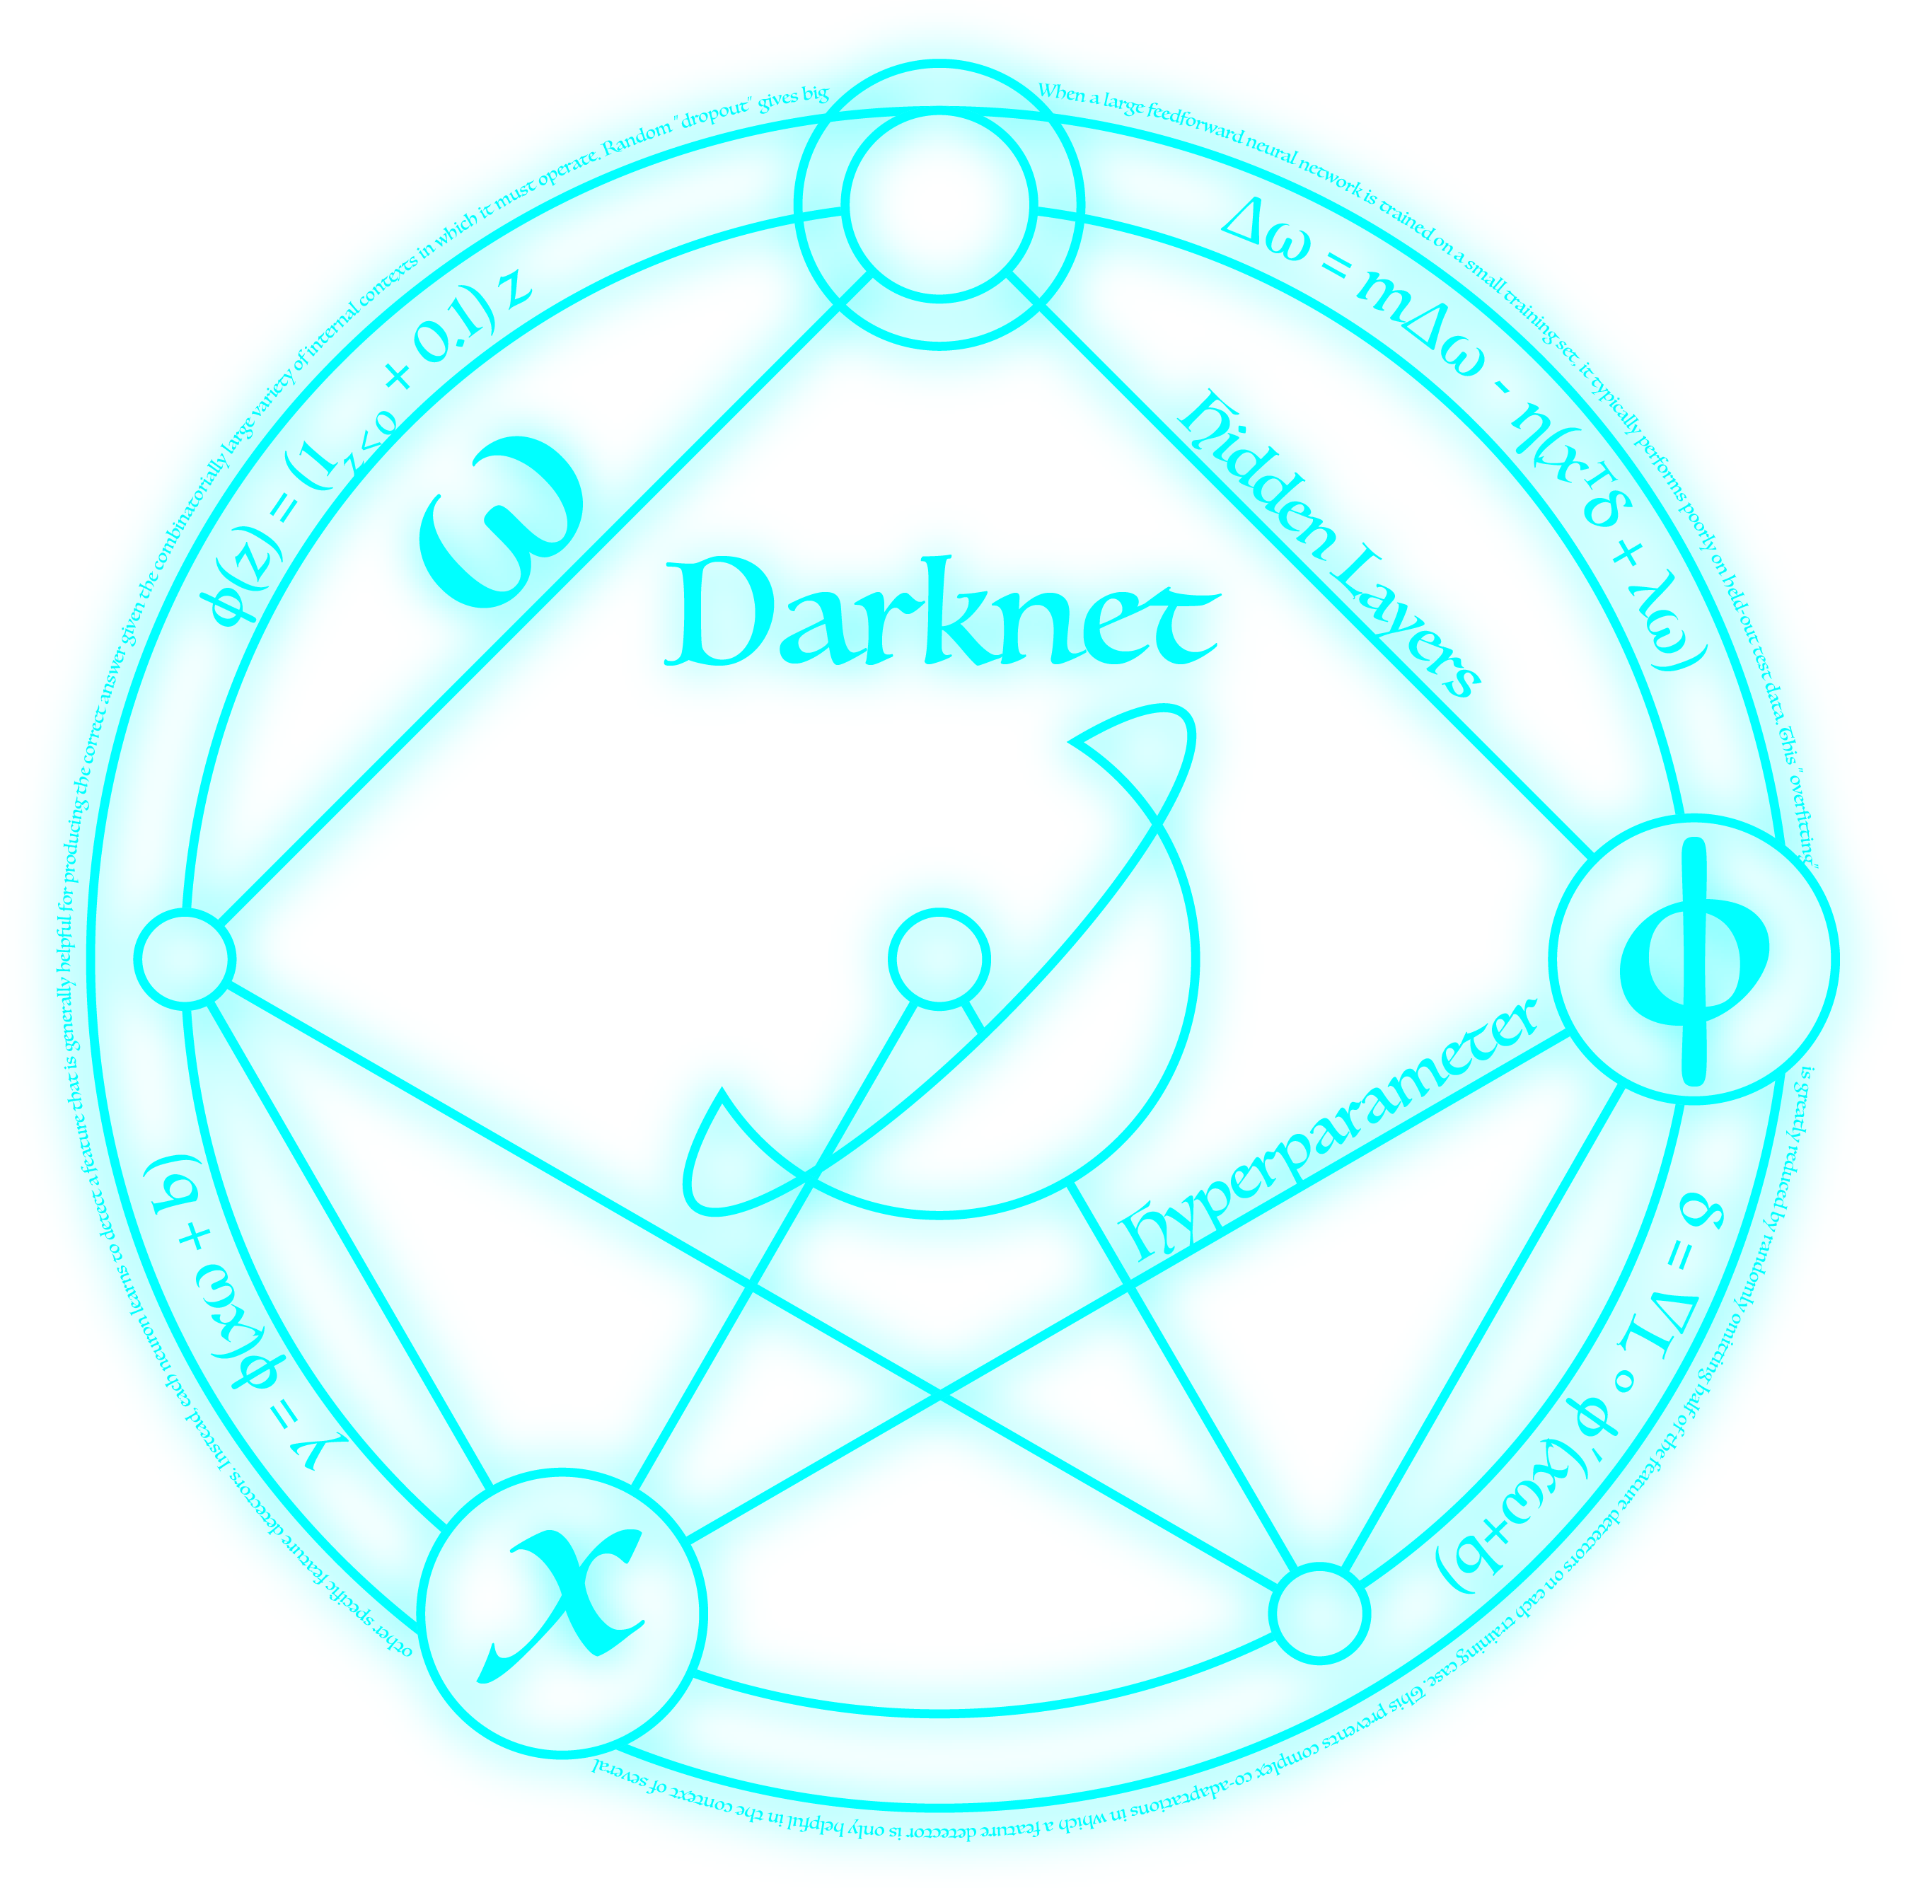

ABOUT YOLO
YOLO (You Only Look Once) is a real-time object detection system
Is based on an open-source neural network framework written in C called Darknet
The YOLO detection system apply a single neural network to the full image.
Is the same network that divides the image into regions and predicts probabilities and bounding boxes for each region
Probabilities are used to weigh bounding boxes
This involves the possibility to perform multi-scale training

Slide 3
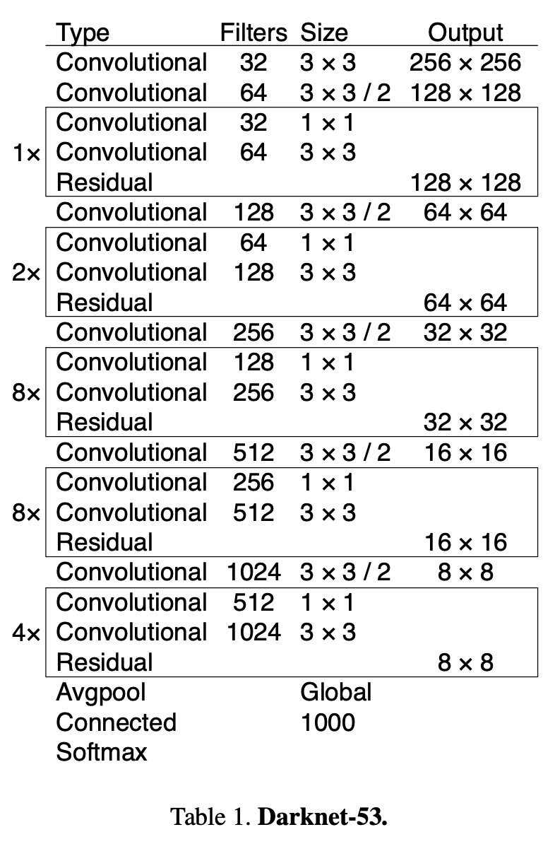
YOLOV3
The version we used is at YOLOv3 this version of YOLO is based on a convolutional neural network called Darknet-53
Improvements over its predecessor Darknet-19 include the use of residual connections and more layers
In YOLOv3 multiscale predictions are used to improve training and increase performances

Slide 4
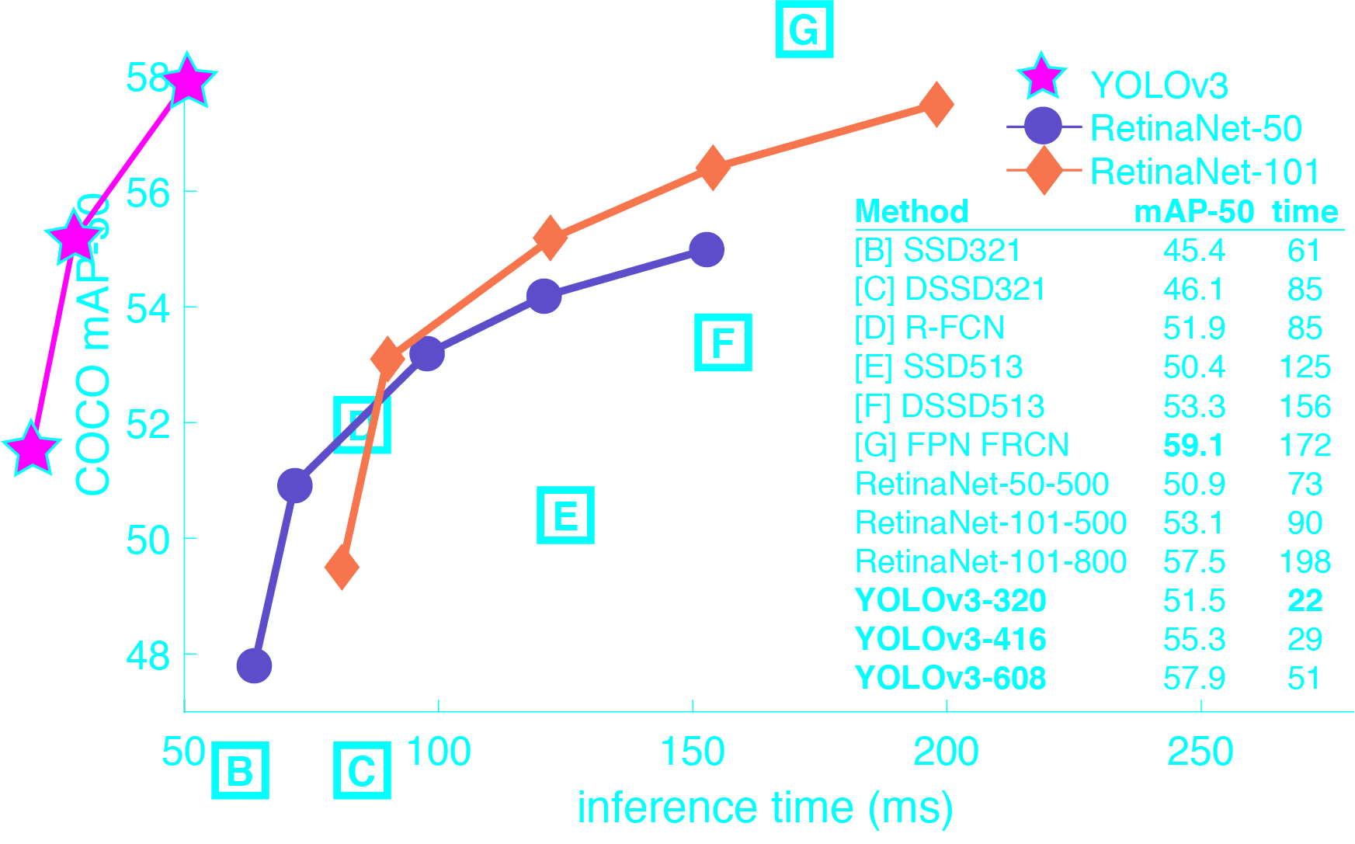
YOLO vs other detectors
Displaying speed/accuracy tradeoff on the mAP at .5 IOU metric
Achieves 57.9 AP50 in 51 ms on a Titan X, compared to 57.5 AP50 in 198 ms by RetinaNet, similar performance but 3.8× faster
Conclusion: YOLOv3 works pretty well

Slide 5
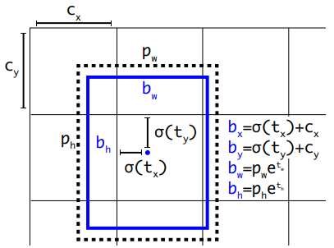
Bounding box prediction
YOLOv3 predicts bounding boxes using dimension clusters as anchor boxes
The network predicts 4 coordinates for each bounding box (t)
YOLOv3 predicts an objectness score for each bounding box using logistic regression
Use the threshold of 0.5
System only assigns one bounding box prior for each ground truth object

Slide 6
What is needed to make it work?
Python version: 3.9.x
Main libraries:
OnpenCV (network and image processing)
Numpy (when we need arrays)

Slide 7
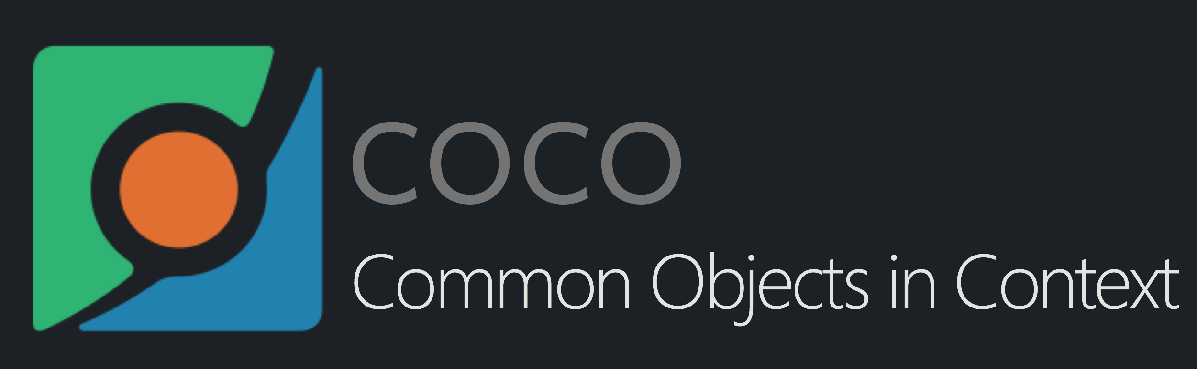
DATASET
YOLO can be trained with different datasets
COCO dataset was chosen:
COCO is a large-scale object detection, segmentation, and captioning dataset
COCO features are:
Object segmentation
Recognition in context
Superpixel stuff segmentation
330K images (>200K labeled)
1.5 milion object instances
80 object categories
91 stuff categories
5 captions per image
250000 people with keypoints

Slide 8
How it works
First of all, it is necessary to load the model
Initialize the input – Webcam
Fed the model with frames
Loop over frames and get out predictions

Slide 9
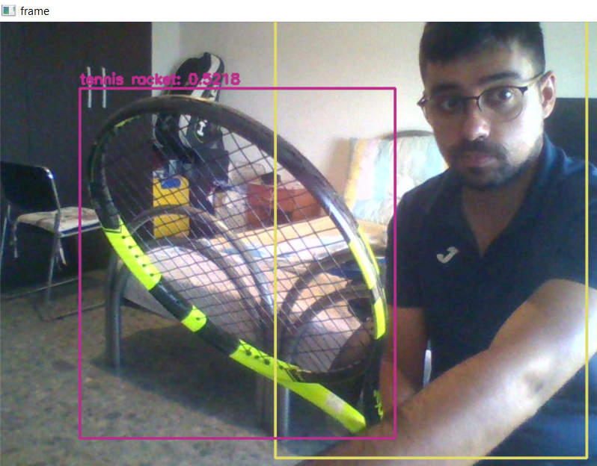
Model Outputs
YOLO provides three different outputs
For each of these we will get bounding boxes and scores
This makes it possible to make predictions on different scales
YOLO provides more than one prediction for each object
Non-Maximum Suppression (NMS) is used to select one result

Slide 10
YOLOv3_tiny
The script also works with the YOLOv3_tiny version
YOLOv3_tiny is a very small model as well for constrained environments

Slide 11
Thank you
For the attention

